Slide 1

Social media as a communication tool in the workplace
Name
Institution
Date

Slide 2
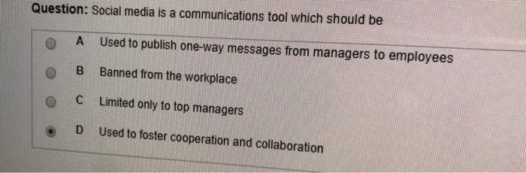
Introduction
Social media is filled with controversy at the workplace.
It is seen as both a good thing and a bad thing.
Embracing social media communication among employees can foster growth in all companies.

Slide 3
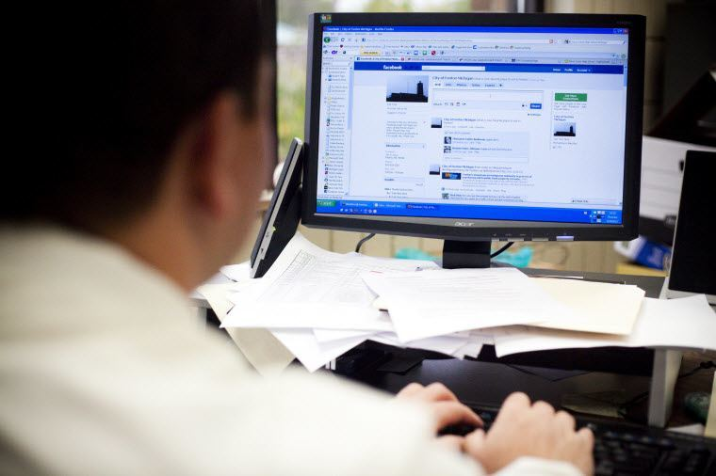
Cons of social media
Decreases productivity.
It causes distractions at work.
Can be time consuming.
Increases technical risks.

Slide 4
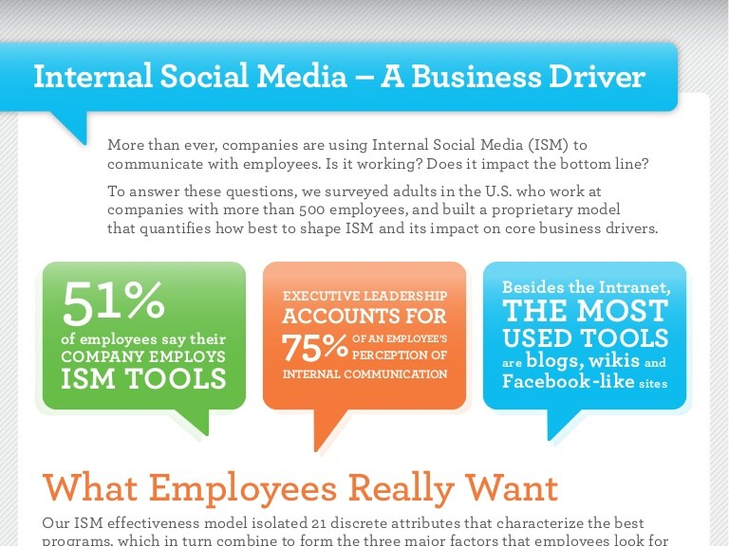
Social media and communication
Social media platforms used at work include Twitter, Facebook, LinkedIn and YouTube.
They are interactive tools, efficient in passing messages, effective when taking breaks, informative and reduce paperwork Oksa et al, 2020).

Slide 5
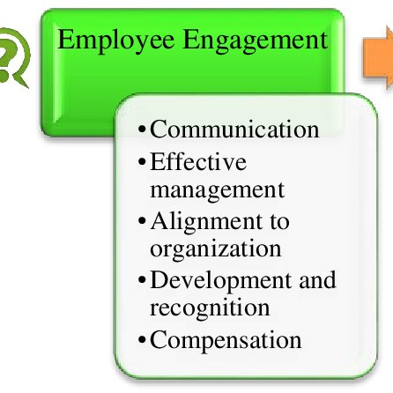
Recognition and Engagement
Recognition makes most employees inspired to work harder.
Through social media, the recognition can be wider and far-reaching.
Managers can engage with their employees online, which is easier than walking across floors to communicate.

Slide 6
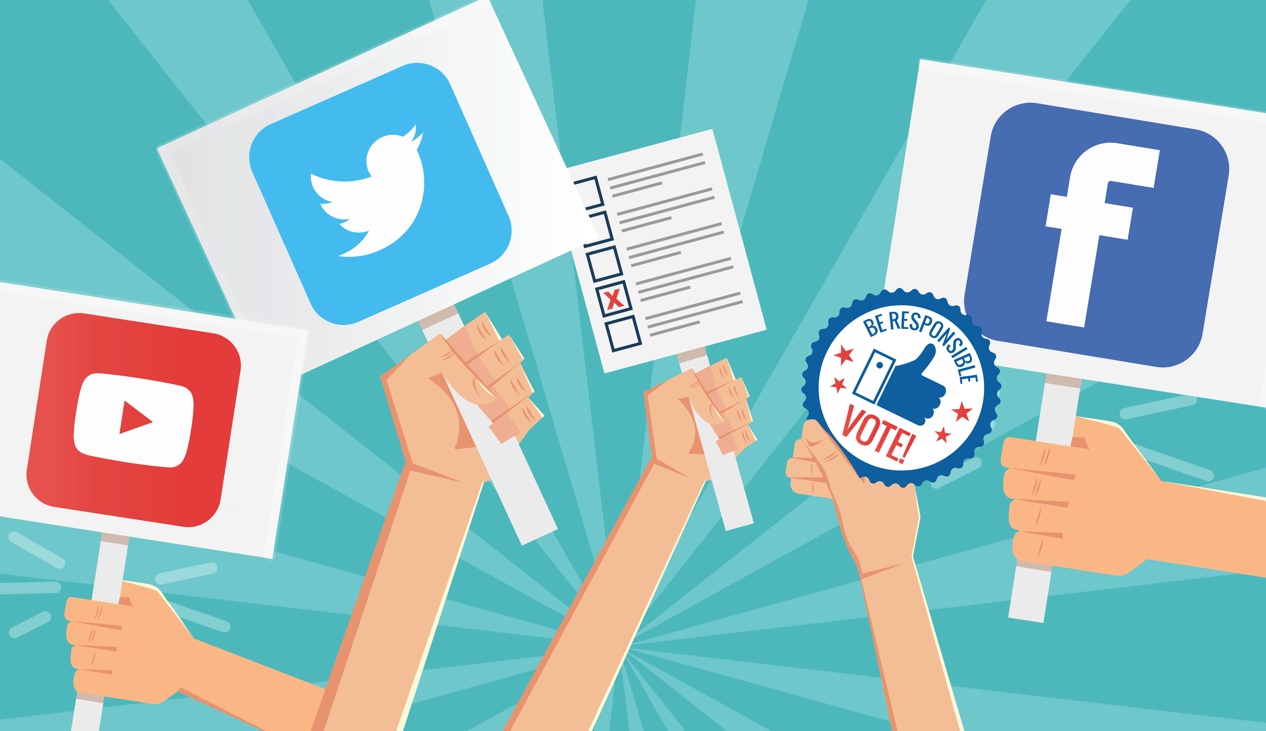
As Interactive tools
Social media platforms are interactive tools.
Polls on Twitter can show statistical preferences between employees in different offices.
Communication through them is far much appealing than bland memos.

Slide 7

Remote working
With more companies embracing remote working due to Covid-19 lockdowns, social media acts like the basic communication tool (Oksa et al, 2020).
Without Zoom calls online meetings apps, business communication would not feel as natural as it feels while people work remotely.

Slide 8
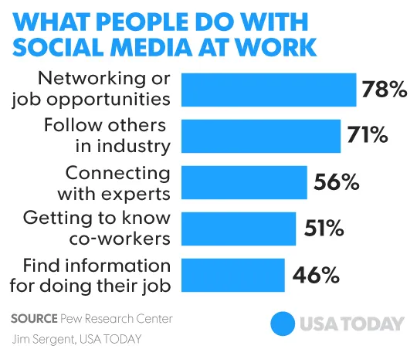
Research and personal development
Twitter and YouTube are filled with content that can increase personal development.
Companies can create handles that encourage and motivate employees, or offer personal development plans (Oksa et al, 2020.

Slide 9
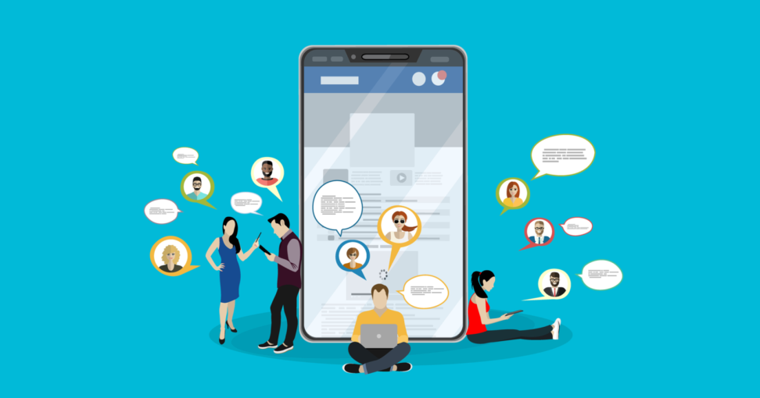
Asking work questions
With social media, employees can ask work problems online and receive real-time answers.
They can also get options through which they can solve problems if they tweet the issue or consult colleagues via WhatsApp groups (Hanna et al, 2017).

Slide 10

Networking
78% of employees use social media at work for networking (Oksa et al, 2020)
56% use it to connect to experts.
71% use it to find others in the same profession (Oksa et al, 2020).
These factors can lead to professional growth, which can boost productivity.

Slide 11

Mental breaks
Short mental breaks to social media can help employees be more productive.
They should be encouraged when one cannot focus, they feel stressed and are feeling mentally exhausted.

Slide 12
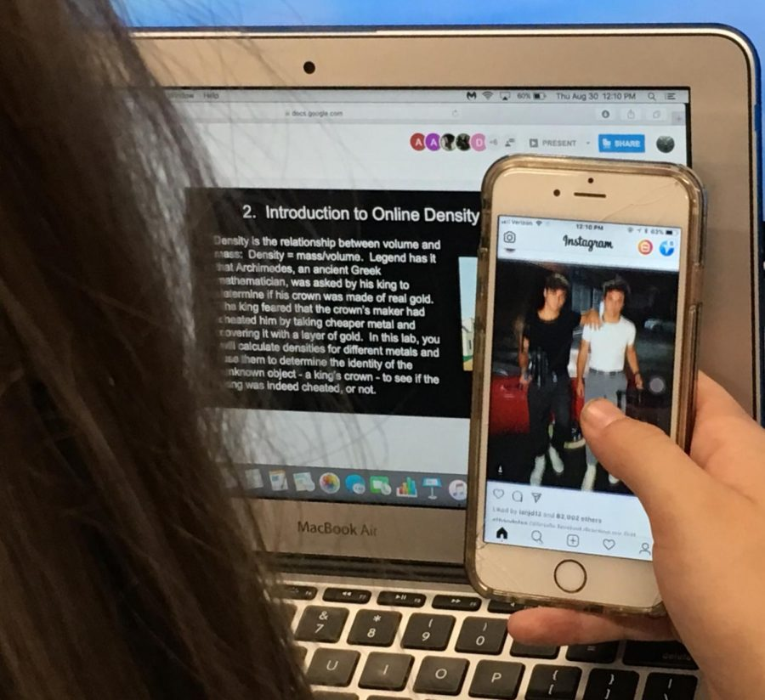
Distractions
Social media is as distracting as any other workplace distraction (Hanna et al, 2017).
Banning its use takes away the benefits companies can get from it.
Solutions should be found as a distraction, but they should not involve doing away with it.

Slide 13
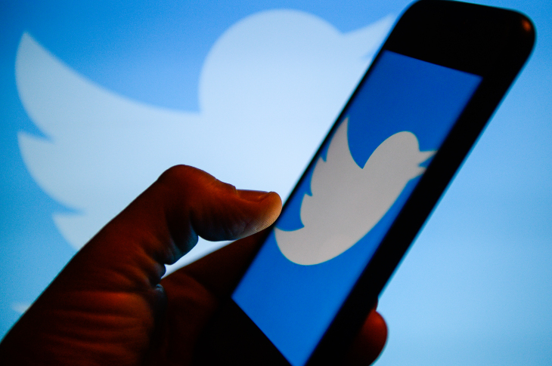
Conclusion
Companies should integrate social media as a communication tool at work because it will its interactive, it will improve engagement, its useful for networking and can be used for mental breaks.

Slide 14
References
Hanna, B., Kee, K. F., & Robertson, B. W. (2017). Positive impacts of social media at work: Job satisfaction, job calling, and Facebook use among co-workers. In SHS web of conferences (Vol. 33, p. 00012). EDP Sciences.
Oksa, R., Kaakinen, M., Savela, N., Ellonen, N., & Oksanen, A. (2020). Professional social media usage: Work engagement perspective. new media & society, 1461444820921938.

